Slide 1

Black Friday Sales Prediction
-Ashish
© All rights reserved by Fireblaze Technologies Pvt. Ltd.

Slide 2
Problem Statement
Why only Male buyers are high?
How can we Attract married people?
Customers from city C spend the most?
© All rights reserved by Fireblaze Technologies Pvt. Ltd.

Slide 3

Proposed Solution
Investigate the reasons behind the higher proportion of male buyers. Look at product preferences, marketing channels, or messaging that may be more appealing to males.
Explore local factors influencing higher spending in City C.
Design promotions for diverse customer interests.
Regularly collect and adapt based on feedback.
© All rights reserved by Fireblaze Technologies Pvt. Ltd.

Slide 4

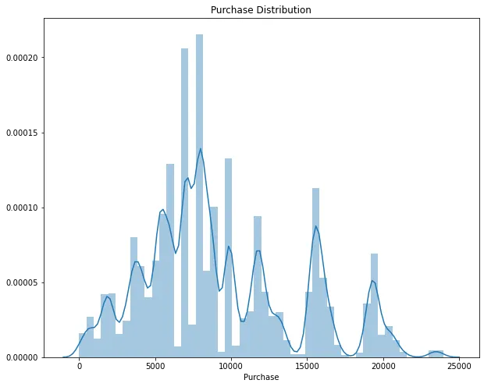
Descriptive Analysis
First part of the graph has a normal distribution and later forming some peaks in the graph.
Evaluating the whole graph, it has a normal distribution
© All rights reserved by Fireblaze Technologies Pvt. Ltd.

Slide 5
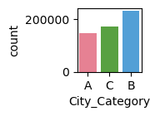
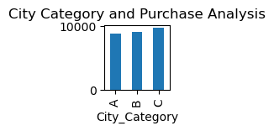
Descriptive Analysis
If we group by City Category to see the variation with purchase, We can see that city category B has made the most number of purchases followed by C.
But We then observe that the customers from city C spends the most
© All rights reserved by Fireblaze Technologies Pvt. Ltd.

Slide 6
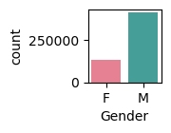
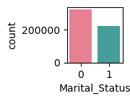
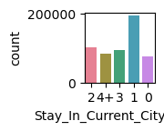
Descriptive Analysis
We observe that male customers have done more transactions than female during Black Friday sales.
There are more unmarried customers in the dataset who purchase more during Black Friday sales.
It looks like the longest customer is living in that city are less prone to buy new things.
whereas Customers which are new in town are more likely to take advantage of the low prices in Black Friday Sales.
© All rights reserved by Fireblaze Technologies Pvt. Ltd.

Slide 7
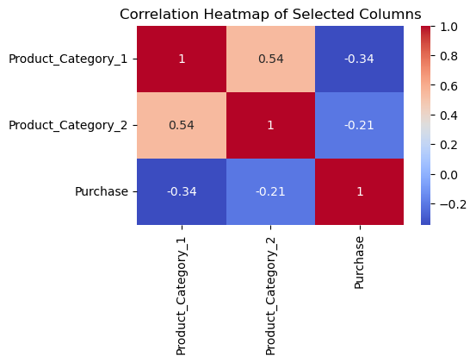
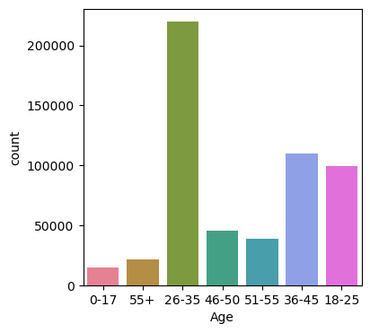
Descriptive Analysis
We can see that the Age group (26–35) makes the most no. of purchases during Black Friday Sales.
© All rights reserved by Fireblaze Technologies Pvt. Ltd.

Slide 8
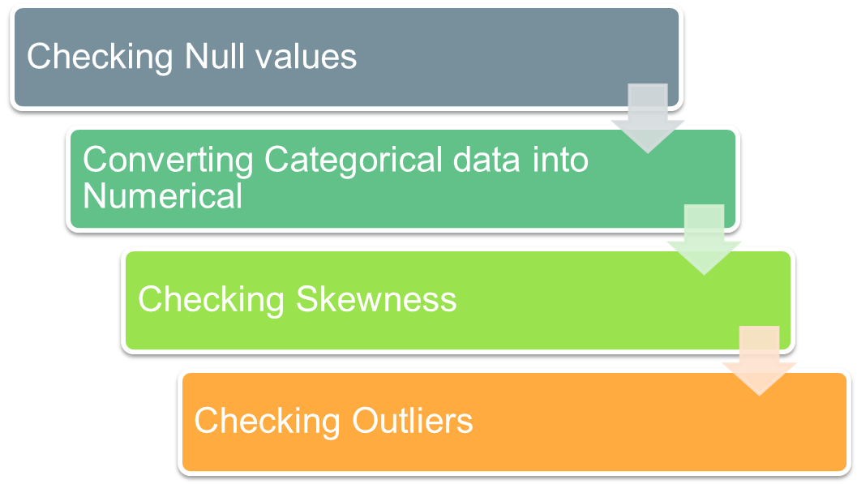
Steps of Data Pre-processing
© All rights reserved by Fireblaze Technologies Pvt. Ltd.

Slide 9
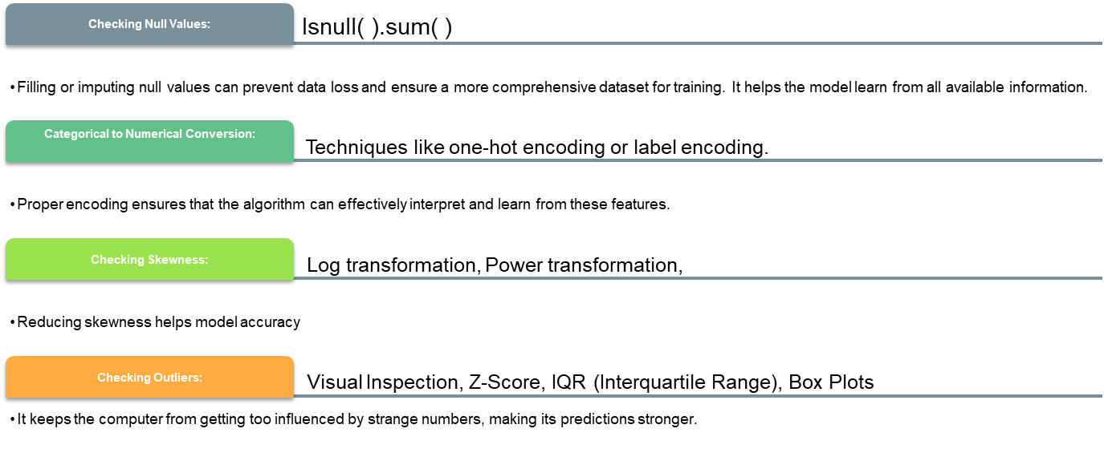
Effect of Data Pre-processing
© All rights reserved by Fireblaze Technologies Pvt. Ltd.

Slide 10
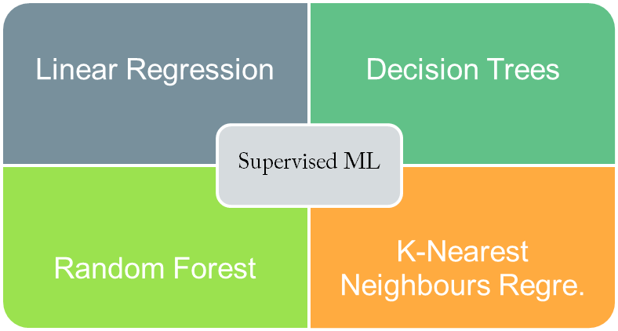
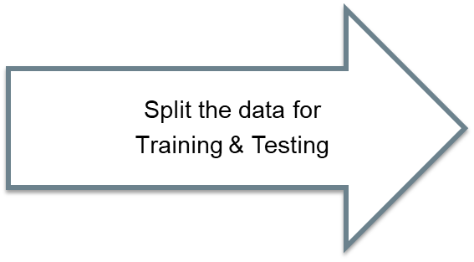
Machine Learning Modelling
© All rights reserved by Fireblaze Technologies Pvt. Ltd.

Slide 11
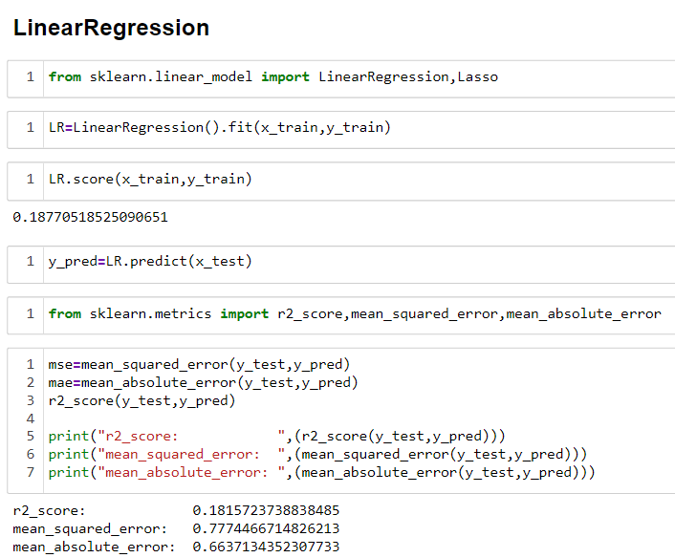
Machine Learning Modelling
Linear Regressor models the relationship between dependent and independent variables as a linear equation
© All rights reserved by Fireblaze Technologies Pvt. Ltd.

Slide 12
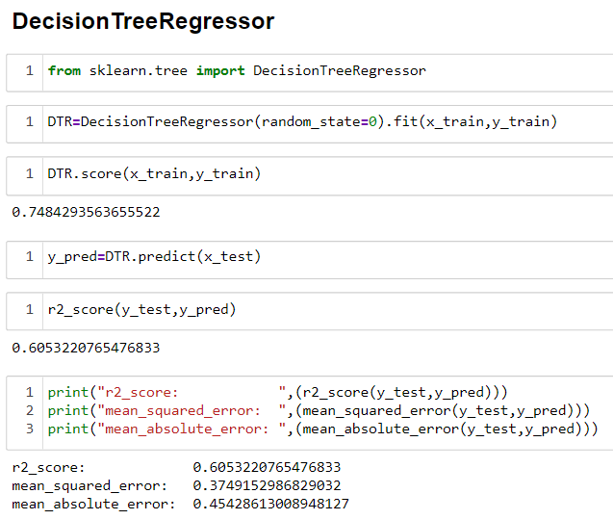
Machine Learning Modelling
Decision Tree Regressor predicts the target variable by recursively partitioning the data into subsets based on features.
© All rights reserved by Fireblaze Technologies Pvt. Ltd.

Slide 13
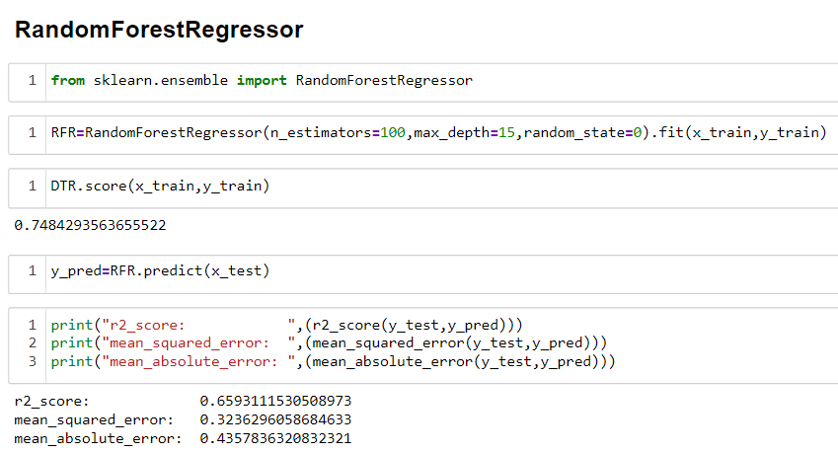
Machine Learning Modelling
Random Forest Regressor is an ensemble learning algorithm.
It builds multiple decision trees during training and outputs the average prediction
© All rights reserved by Fireblaze Technologies Pvt. Ltd.

Slide 14
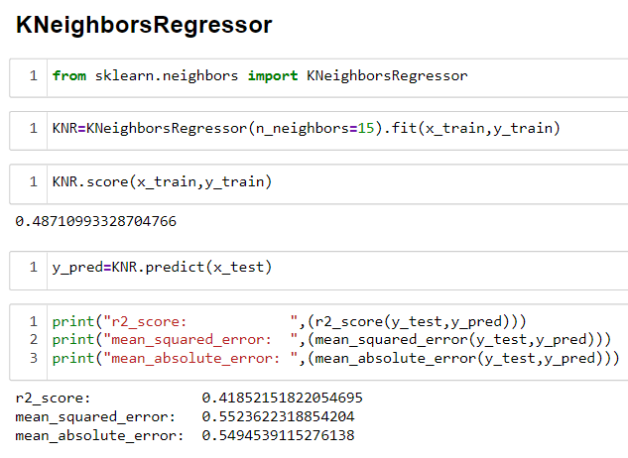
Machine Learning Modelling
KNNR predicts the target variable by averaging the values of its k-nearest neighbours in the feature space.
© All rights reserved by Fireblaze Technologies Pvt. Ltd.

Slide 15
Conclusion
Fixing Data Helps Computers: Cleaning and organizing data is like helping computers understand things better. It's like cleaning up a room so they can find what they need.
Smart Choices Make Computers Smarter: Making good choices with data, like fixing missing parts and strange things, helps computers learn well without getting confused.
© All rights reserved by Fireblaze Technologies Pvt. Ltd.

Slide 16

Future Scope
Understand Your Customers: Figure out what Female like by doing some research.
Speak to Females in Ads:
Targeted Marketing: Create marketing campaigns specifically designed to appeal to unmarried customers. Highlight products or deals that are likely to interest this demographic.
© All rights reserved by Fireblaze Technologies Pvt. Ltd.

